Slide 1
CIS CONTROL 13: DATA PROTECTION-III
DATA PROTECTION

Slide 2
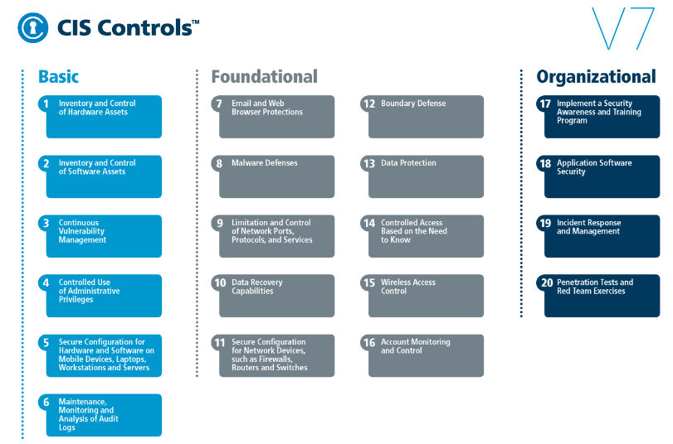
CIS CONTROL 13: DATA PROTECTION-III
https://www.cisecurity.org/controls/

Slide 3
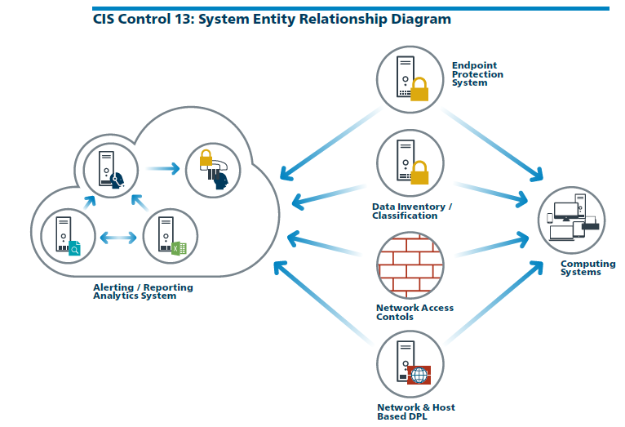
CIS CONTROL 13: DATA PROTECTION-III
https://www.cisecurity.org/controls/

Slide 4
CIS CONTROL 13: DATA PROTECTION-III
13.7: Manage USB Devices
If USB storage devices are required, enterprise software should be used that can configure systems to allow the use of specific devices. An inventory of such devices should be maintained.

Slide 5
CIS CONTROL 13: DATA PROTECTION-III
13.8: Manage System's External Removable Media's Read/write Configurations
Configure systems not to write data to external removable media, if there is no business need for supporting such devices.

Slide 6
CIS CONTROL 13: DATA PROTECTION-III
13.9: Encrypt Data on USB Storage Devices
If USB storage devices are required, all data stored on such devices must be encrypted while at rest.
END

